Slide 1

Josh / Li Jie / Jia Sheng / Andrel
{ FS7T03 }

Slide 2
INTRODUCTION &
PRACTICAL MOTIVATION
01
DATA PREPARATION &
EXPLORATORY ANALYSIS
02
OUTCOMES
03
Introduction to the Problem, Our Approach
Cleaning data, Calculating New Metrics
Practical Uses for Our Findings

Slide 3
Introduction

Slide 4
PROBLEM STATEMENT
“What should we include in a listing description to increase chances of success?”
Notes:
We want to detect popular keywords in descriptions and use them for recommendations to both hosts and guests.

Slide 5

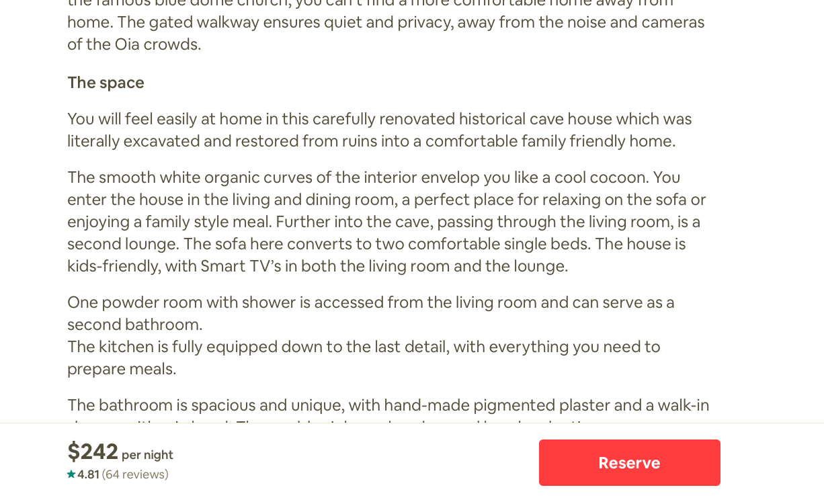
{ Host Interface }
Lengthy Descriptions
Open-ended descriptions
No help given on traits that guests are looking for.

Slide 6
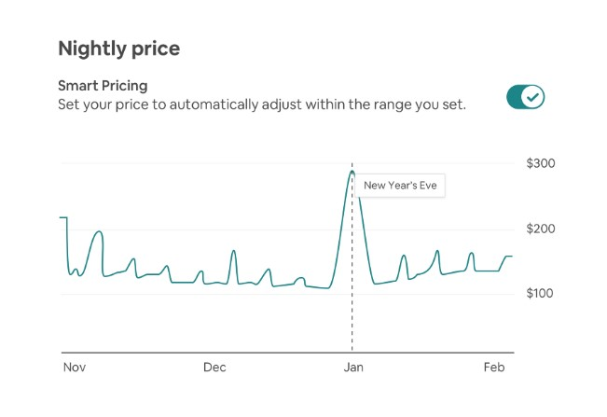
{ Host Interface }
Smart Pricing
Price recommendations based on some factors.
(Eg. min/max price)
Possible improvements
Notes:
Fair or transparent pricing

Slide 7
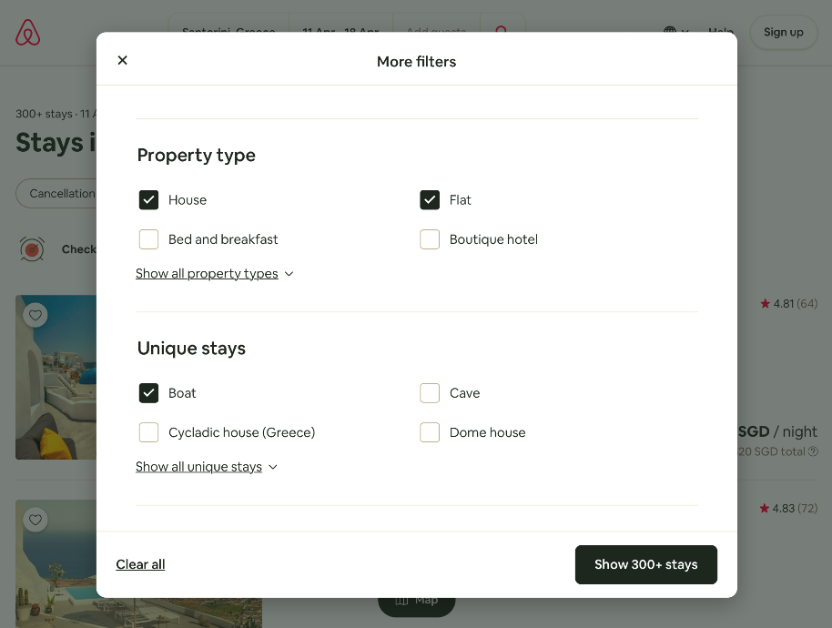
Limited Filters
{ Guest Interface }
Filter by amenities, facilities, property type, neighbourhood etc.
Unable to filter by other descriptives of listing
(Eg. quiet, safe for women, accessible to nightclubs)
Notes:
.

Slide 8
OUR APPROACH
Examine reviews
and descriptions of
successful listings
Provide options to list
those traits for their homes, with clustered price class.
01
03
Use a metric to find
successful listings
Find common traits used for describing successful or unsuccessful listings.
02
04
Notes:
Find successful listings based on our own metric (user sentiments + review ratings)
Examine reviews and descriptions of the most successful listings
Find out traits that are commonly used to describe the largest number of successful listing. (vice versa, find less ideal traits from unsuccessful listings)
propose a change to AirBnB host and guest interface, give options to list these traits for their homes.

Slide 9


{ Improvements }
Text Processing
Ideal Matching
Allow user-defined descriptions through text processing.
Discover what guests like
with successful listings.
Match guest to ideal house from descriptions and similar keywords after text processing.

Slide 10
Data Preparation

Slide 11
Libraries Used
Pandas
VADER sentiment analysis
Natural Language ToolKit

Slide 12
Data Preparation
Metrics of score, Remove invalid data
Extract meaningful words from reviews & comments

Slide 13
Sentiment Analysis
Using VADER and NLTK
Shows the reviewer’s mood towards the listing

Slide 14
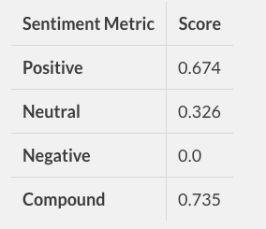
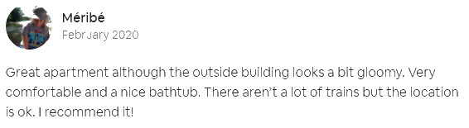
VADER Sentiment Analysis
What It Does
Sentiment Metric | Score
Positive | 0.674
Neutral | 0.326
Negative | 0.0
Compound | 0.735
VADER evaluates text and gives them a general sentiment score
Why We Used It
Reviews were all generally positive, with minor criticism hidden within the reviews
How We Used It
February 2020
Average Sentiment Score of each listing
Great apartment although the outside building looks a bit gloomy. Very comfortable and a nice bathtub. There aren’t a lot of trains but the location is ok. I recommend it!
Notes:
Instead of relying on numeric data, we wanted to analyze the data more thoroughly and include reviews as part of our analysis

Slide 15
Metrics of total_score
Sentiment Score
Review Scores
Location,
Superhost,
Reviews Count
Notes:
60% Review Score
25% Sentiment Score
15% Others

Slide 16
Outcomes

Slide 17
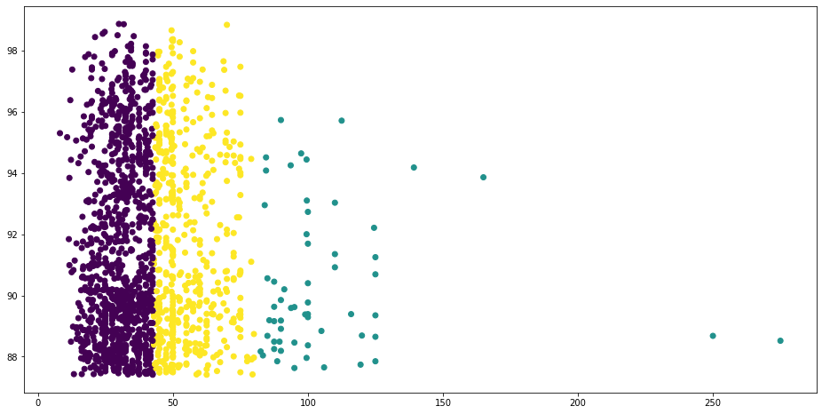
ML Technique: Clustering
Clustering of Price Range
Price Class Analysis: High, Mid, Low
Scatterplot

Slide 18
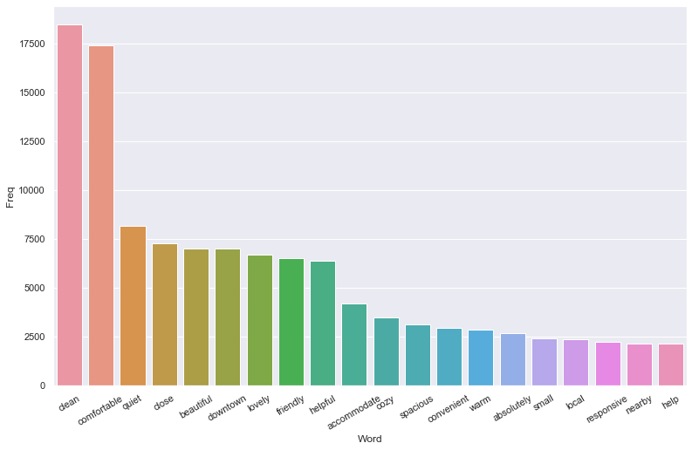
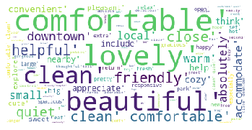
Pattern Recognition
Visualisations of Most Commonly Used Words in Reviews
Barplot
Word cloud

Slide 19
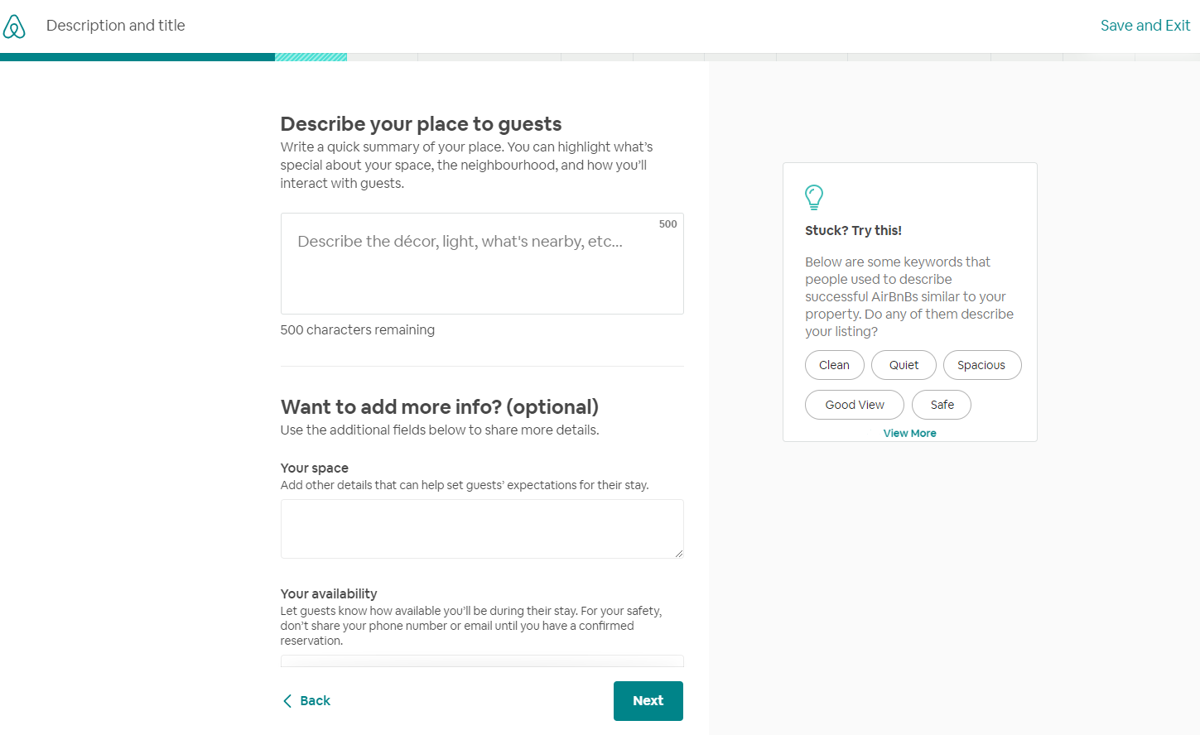

Slide 20
TEAM
Josh
Li Jie
Sentiment Analysis, Clustering
Code Compilation
Data Cleaning, Data Extraction
Code Compilation
Jia Sheng
Andrel
Data Preparation
Price Class Analysis
Metrics of Score
Presentation Slides

Slide 21
Thank you!

